Slide 1
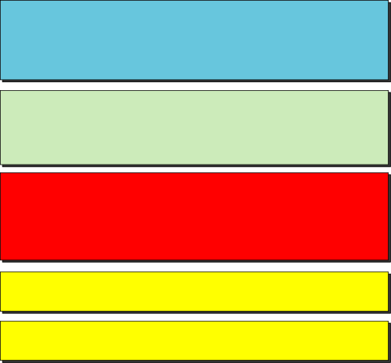
Chapter 18
Remote Login:
Telnet
Objectives
Upon completion you will be able to:
Understand how TELNET works
Understand the role of NVT in a TELNET communication
Understand TELNET option and suboption negotiation
Know how control characters are used
Know the TELNET modes of operation

Slide 2
Note:
TELNET is a general-purpose client-server application program.

Slide 3
18.1 CONCEPT
TELNET enables the establishment of a connection to a remote system in such a way that the local terminal appears to be a terminal at the remote system.
The topics discussed in this section include:
Time-Sharing Environment
Login

Slide 4
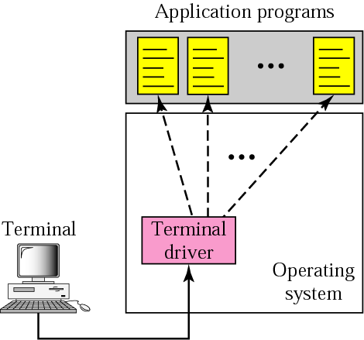
Figure 18.1 Local login

Slide 5
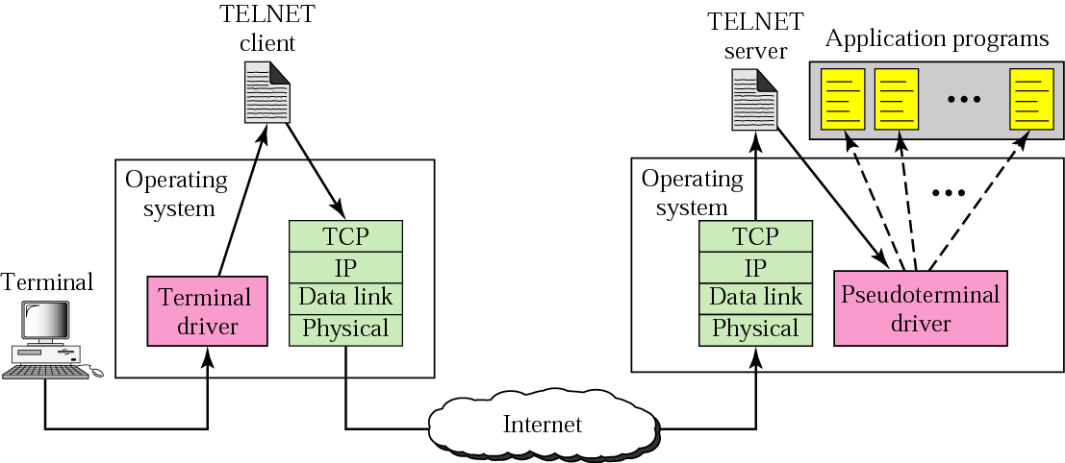
Figure 18.2 Remote login

Slide 6
18.2 NETWORK VIRTUAL TERMINAL (NVT)
Via a universal interface called the Network Virtual Terminal (NVT) character set, the TELNET client translates characters (data or commands) that come from the local terminal into NVT form and delivers them to the network. The TELNET server translates data and commands from NVT form into the form acceptable by the remote computer.

Slide 7
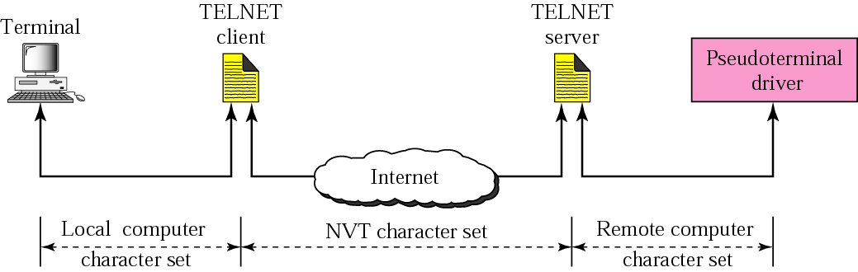
Figure 18.3 Concept of NVT

Slide 8
18.3 NVT CHARACTER SET
NVT uses two sets of characters, one for data and one for control. Both are 8-bit bytes.
The topics discussed in this section include:
Data Characters
Control Characters

Slide 9
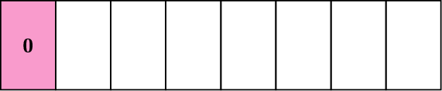
Figure 18.4 Format of data characters

Slide 10
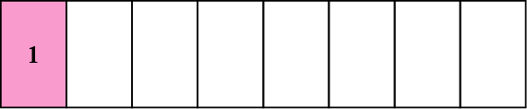
Figure 18.5 Format of control characters

Slide 11
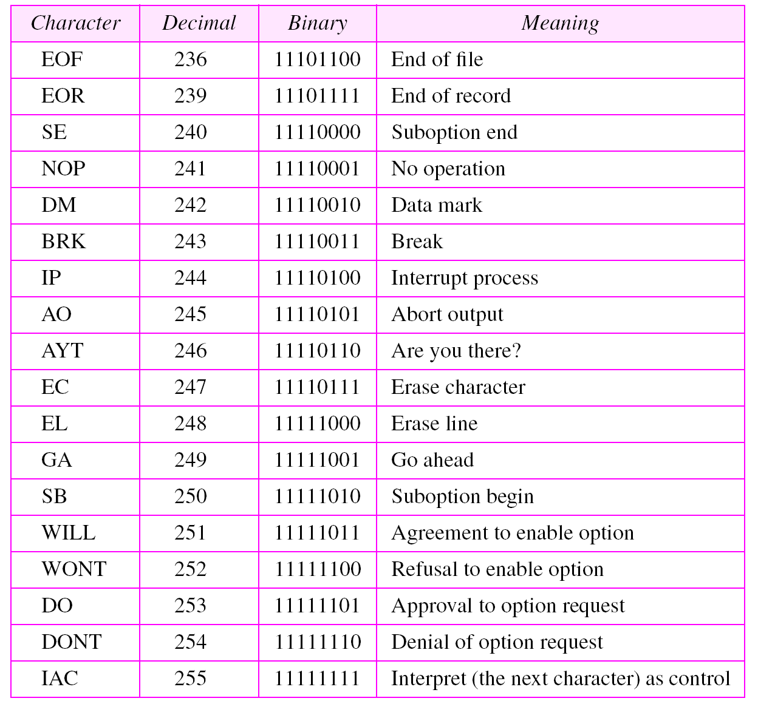
Table 18.1 Some NVT control characters

Slide 12
18.4 EMBEDDING
The same connection is used by TELNET for sending both data and control characters. TELNET accomplishes this by embedding the control characters in the data stream.

Slide 13
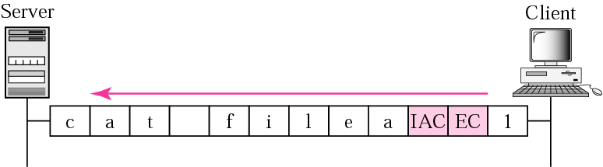
Figure 18.6 An example of embedding

Slide 14
18.5 OPTIONS
TELNET lets the client and server negotiate options before or during the use of the service. Options are extra features available to a user with a more sophisticated terminal.

Slide 15
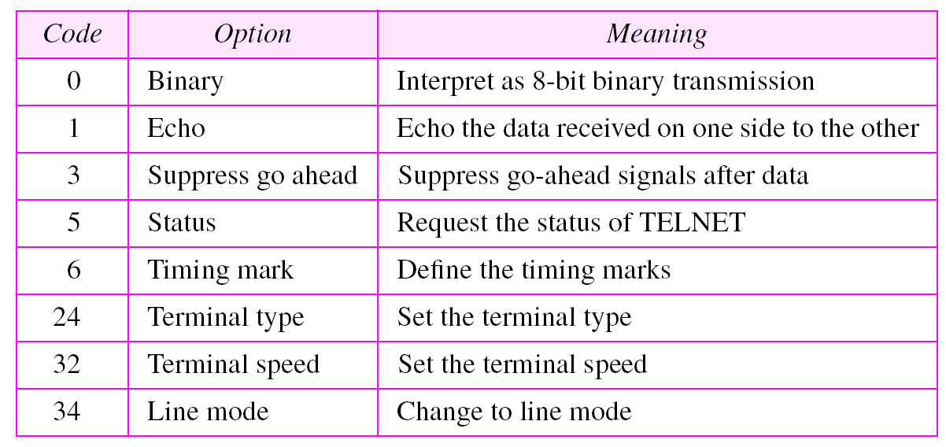
Table 18.2 Options

Slide 16
18.6 OPTION NEGOTIATION
To use any of the options first requires option negotiation between the client and the server. Four control characters are used for this purpose.
The topics discussed in this section include:
Enabling an Option
Disabling an Option
Symmetry

Slide 17
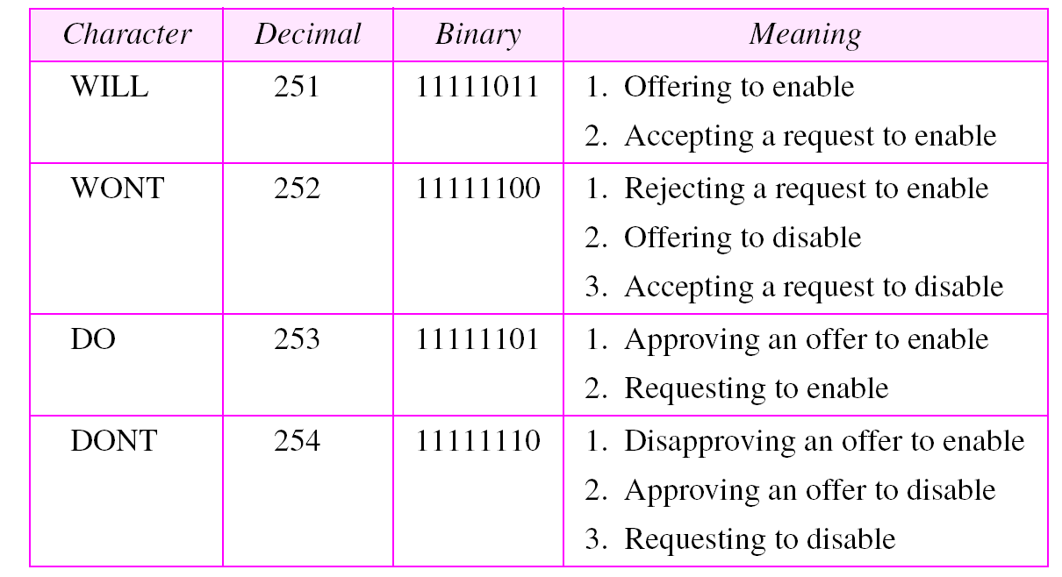
Table 18.3 NVT character set for option negotiation

Slide 18
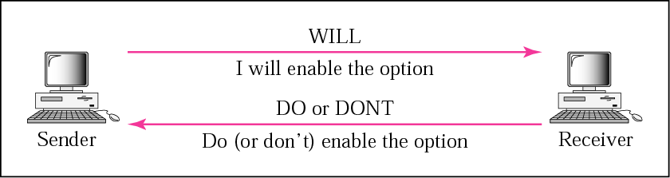
Figure 18.7 Offer to enable an option

Slide 19
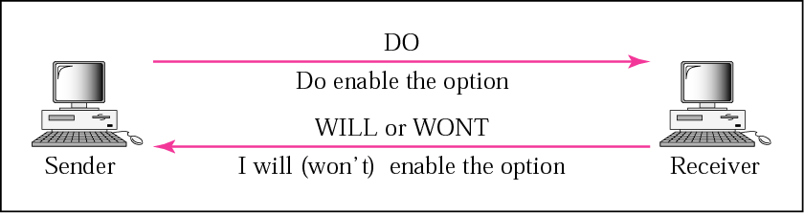
Figure 18.8 Request to enable an option

Slide 20
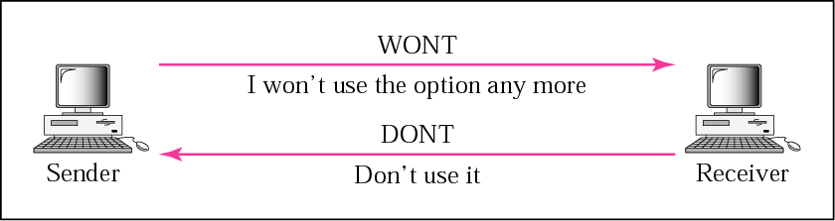
Figure 18.9 Offer to disable an option

Slide 21
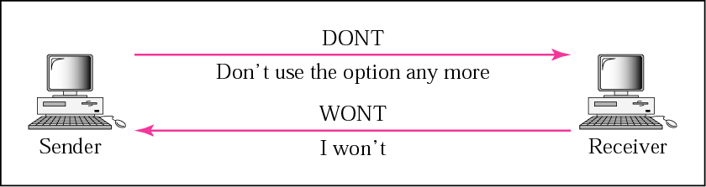
Figure 18.10 Request to disable an option

Slide 22
Example 1
Figure 18.11 shows an example of option negotiation. In this example, the client wants the server to echo each character sent to the server. In other words, when a character is typed at the user keyboard terminal, it goes to the server and is sent back to the screen of the user before being processed. The echo option is enabled by the server because it is the server that sends the characters back to the user terminal. Therefore, the client should request from the server the enabling of the option using DO. The request consists of three characters: IAC, DO, and ECHO. The server accepts the request and enables the option. It informs the client by sending the three character approval: IAC, WILL, and ECHO.
See Next Slide

Slide 23
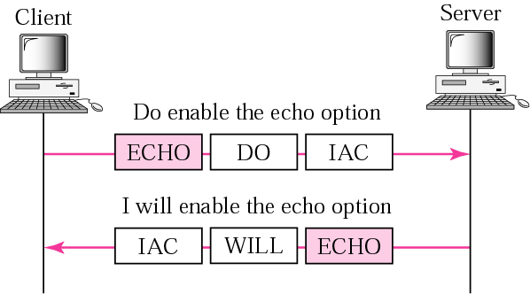
Figure 18.11 Example 1: Echo option

Slide 24
18.7 SUBOPTION NEGOTIATION
Some options require additional information. The client and server agree through a process called suboption negotiation.

Slide 25
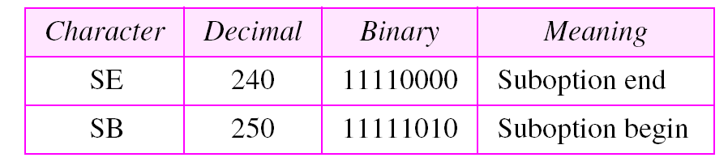
Table 18.4 NVT character set for suboption negotiation

Slide 26
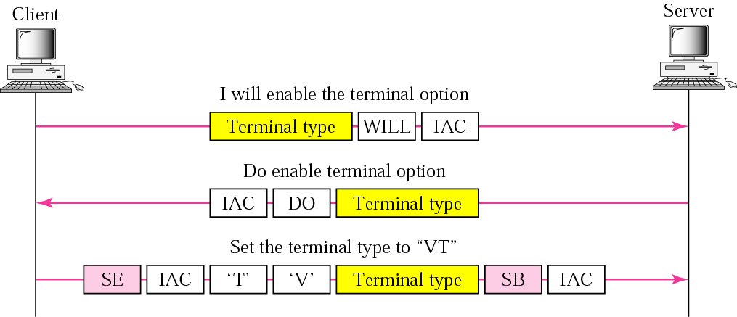
Figure 18.12 Example of suboption negotiation

Slide 27
18.8 CONTROLLING THE SERVER
Control characters can be used to control the remote server.

Slide 28
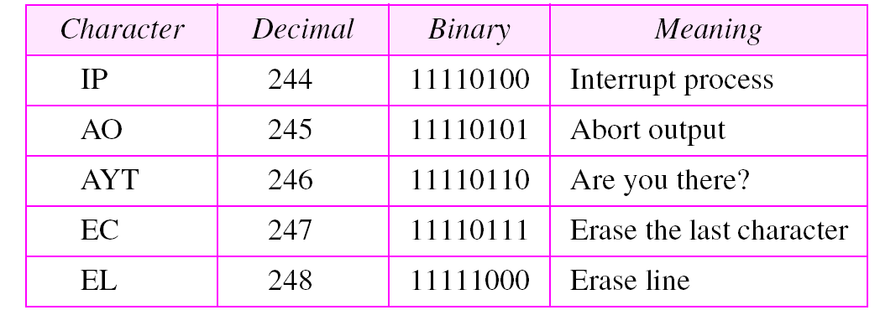
Table 18.5 Characters used to control the application program running on remote server

Slide 29
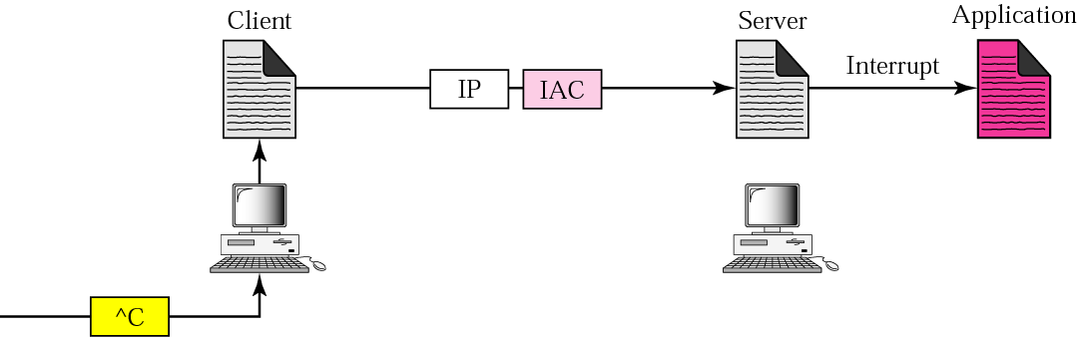
Figure 18.13 Example of interrupting an application program

Slide 30
18.9 OUT-OF-BAND SIGNALING
To make control characters effective in special situations, TELNET uses out-of-band signaling, a technique in which the control characters are preceded by IAC and are sent out of order to the remote process.

Slide 31
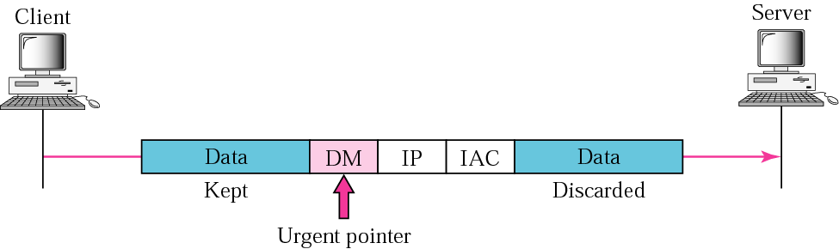
Figure 18.14 Out-of-band signaling

Slide 32
18.10 ESCAPE CHARACTER
When a user wants characters interpreted by the client instead of the server, he can use an escape character, normally Ctrl+] (shown as ^]).

Slide 33
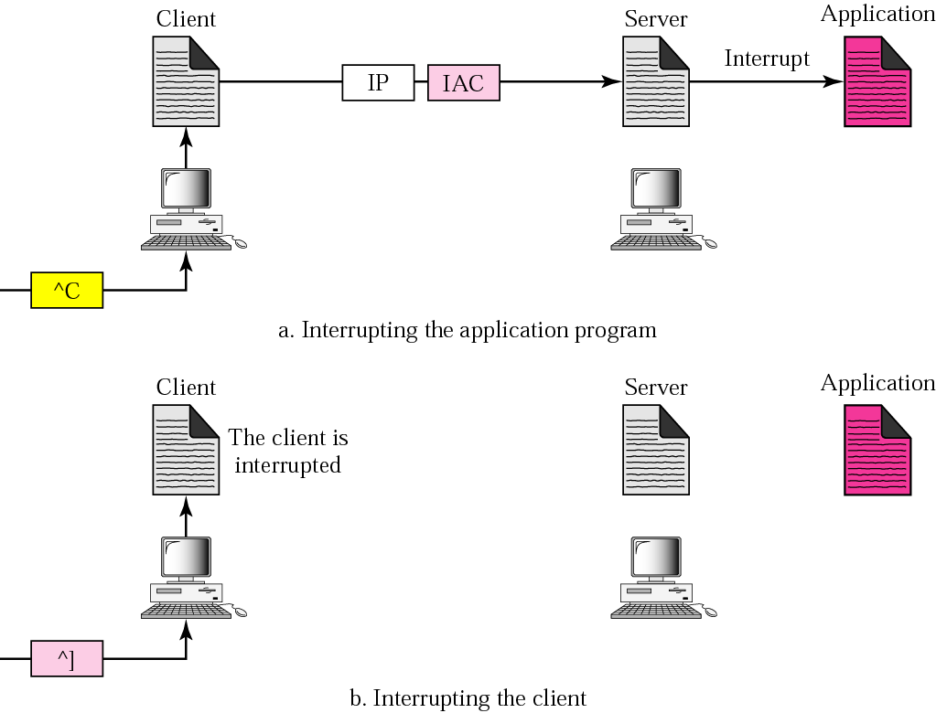
Figure 18.15 Two different interruptions

Slide 34
18.11 MODE OF OPERATION
Most TELNET implementations operate in one of three modes: default mode, character mode, or line mode.
The topics discussed in this section include:
Default Mode
Character Mode
Line Mode

Slide 35
Example 2
In this example, we use the default mode to show the concept and its deficiencies even though it is almost obsolete today. The client and the server negotiate the terminal type and terminal speed and then the server checks the login and password of the user (see Figure 18.16).
See Next Slide

Slide 36
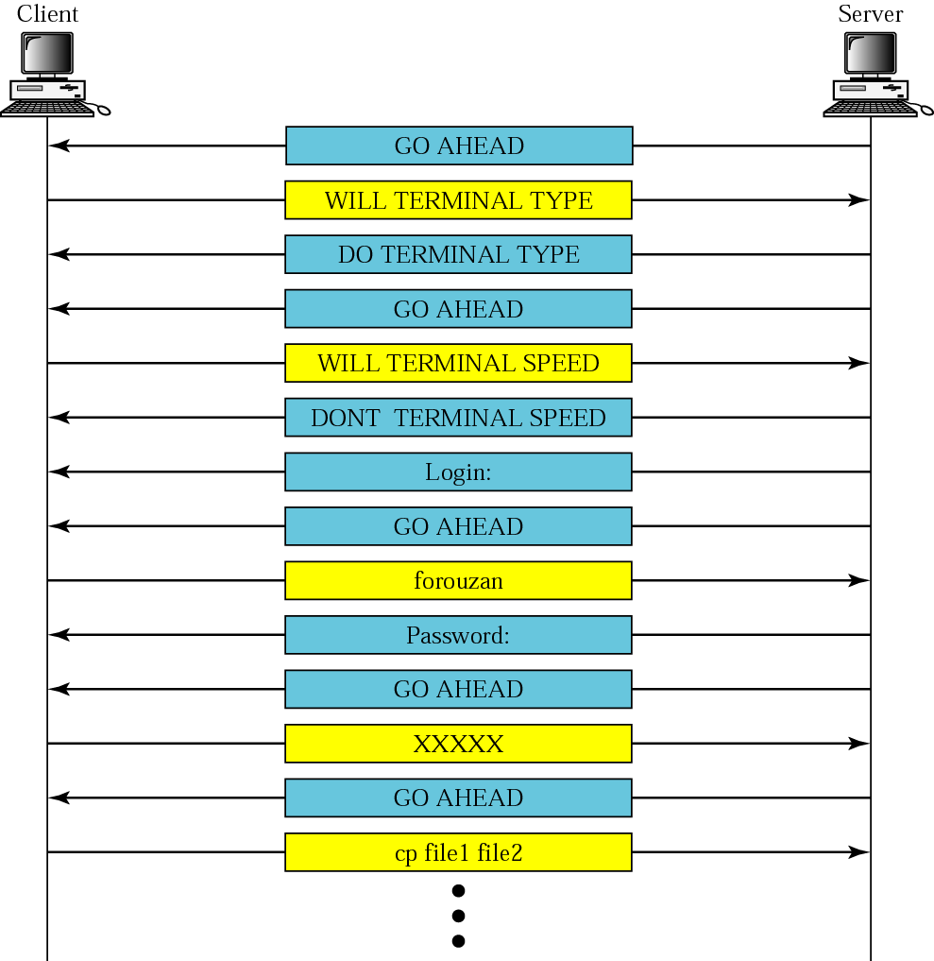
Figure 18.16 Example 2

Slide 37
Example 3
In this example, we show how the client switches to the character mode. This requires that the client request the server to enable the SUPPRESS GO AHEAD and ECHO options (see Figure 18.17).
See Next Slide

Slide 38
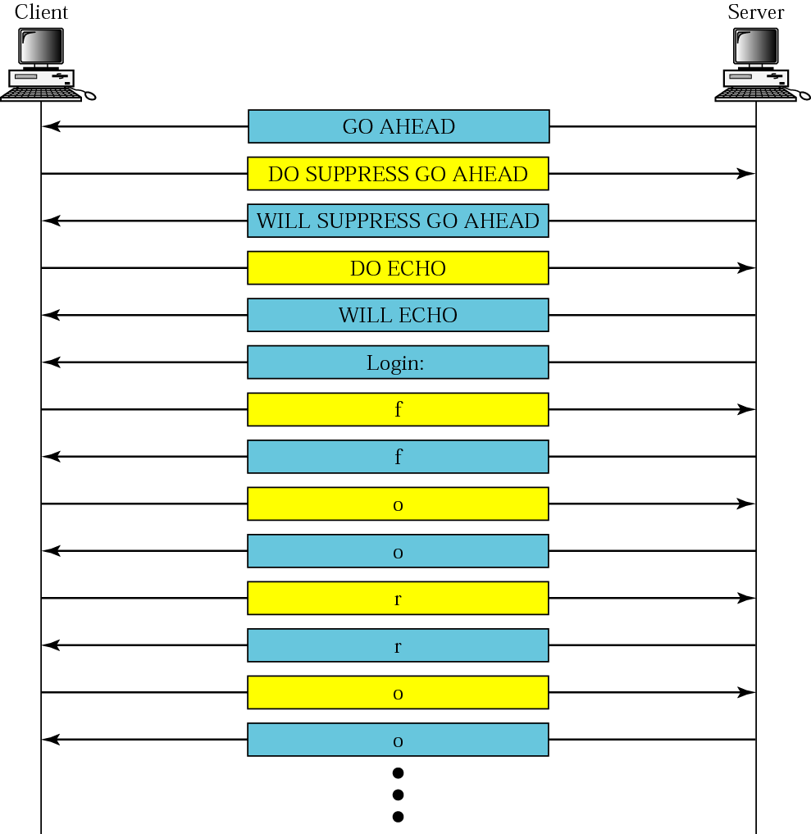
Figure 18.17 Example 3

Slide 39
18.12 USER INTERFACE
The operating system (UNIX, for example) defines an interface to TELNET with user-friendly commands. The interface is responsible for translating the user-friendly commands to the TELNET commands.

Slide 40
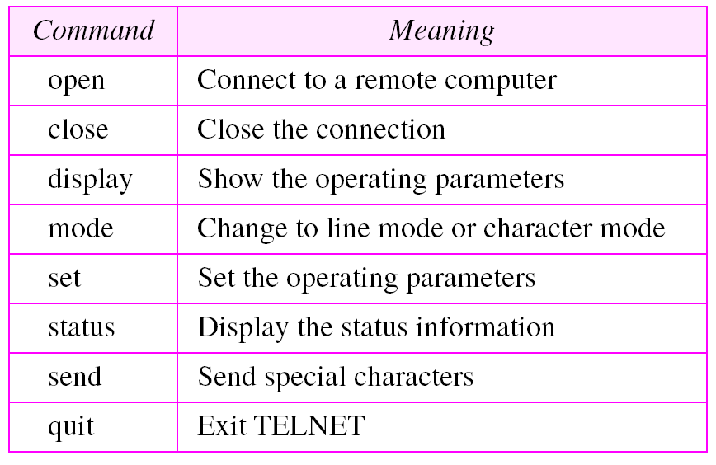
Table 18.6 Examples of interface commands

